Slide 1

Latest version- 5.0.6
KRITA
GRAPHICS
ANIMATION
https://krita.org/en/
By- Santosh Kumar Bisen , Fulbright DAI Scholar- 9340089454

Slide 2
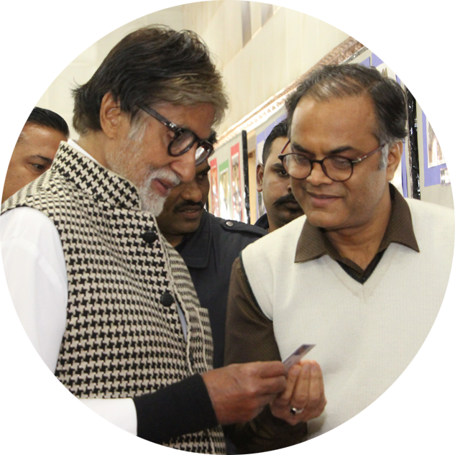
Webinar by -
Santosh Kumar Bisen
Fulbright DAIScholar and National ICT,NAT Awardee
PGT Biology at JNV RAIPR (CG)
WEBINAR ON 2D ANIMATION – KRITA by Santosh Kumar Bisen (NVS BHOPAL)

Slide 3


WEBINAR ON
2D ANIMATION – KRITA
__________________________
Santosh Kumar Bisen
Fulbright DAI Scholar and National ICT + NAT Awardee
PGT Biology at JNV RAIPUR (CG)
WEBINAR ON 2D ANIMATION – KRITA by Santosh Kumar Bisen (NVS BHOPAL)

Slide 4

Digital Graphics
By- Santosh Kumar Bisen , Fulbright DAI Scholar- 9340089454

Slide 5
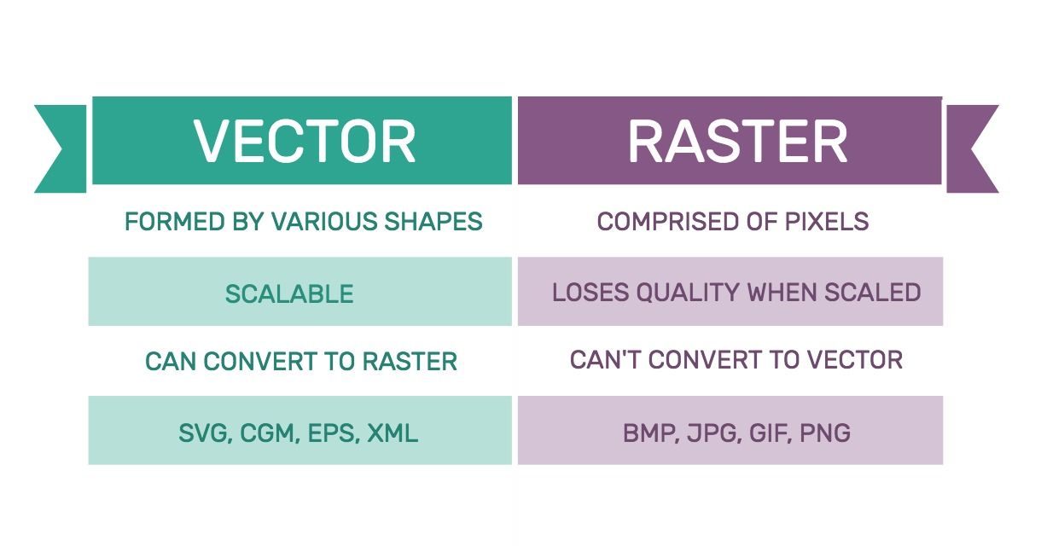

By- Santosh Kumar Bisen , Fulbright DAI Scholar- 9340089454

Slide 6
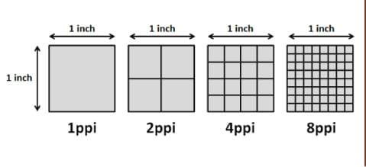
Pixel per inch
By- Santosh Kumar Bisen , Fulbright DAI Scholar- 9340089454

Slide 7
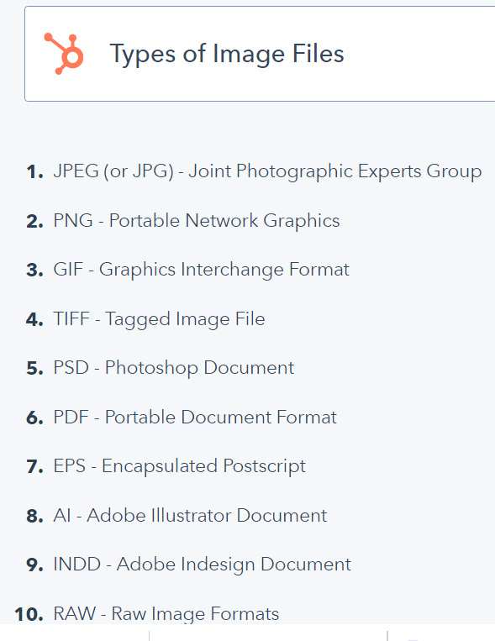
By- Santosh Kumar Bisen , Fulbright DAI Scholar- 9340089454

Slide 8


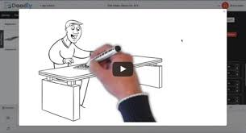

ANIMATION
2D animation
(Tom & Jerry)
3D animation
(Ice Age)
Stop motion [Wallace and Gromit)
Motion graphics
(Doodly)

Slide 9
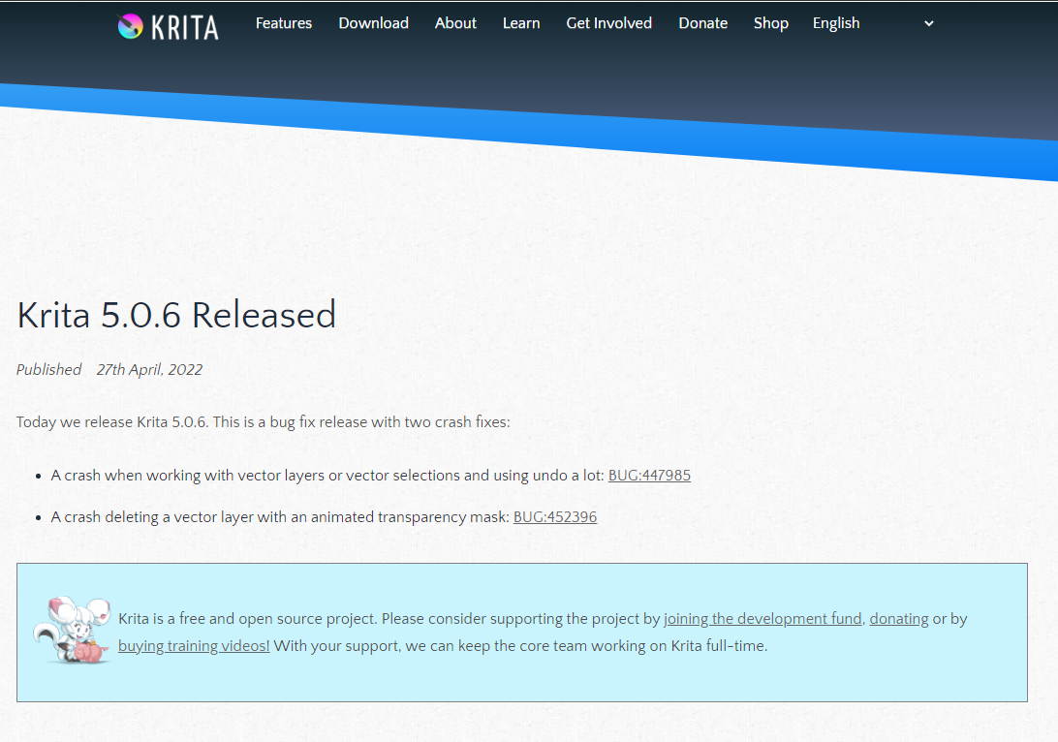
By- Santosh Kumar Bisen , Fulbright DAI Scholar- 9340089454

Slide 10
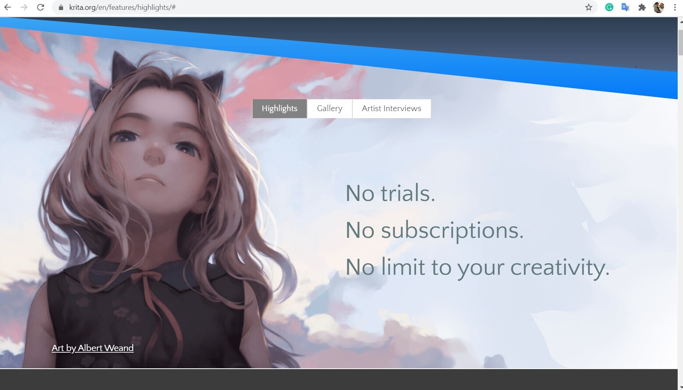
By- Santosh Kumar Bisen , Fulbright DAI Scholar- 9340089454

Slide 11
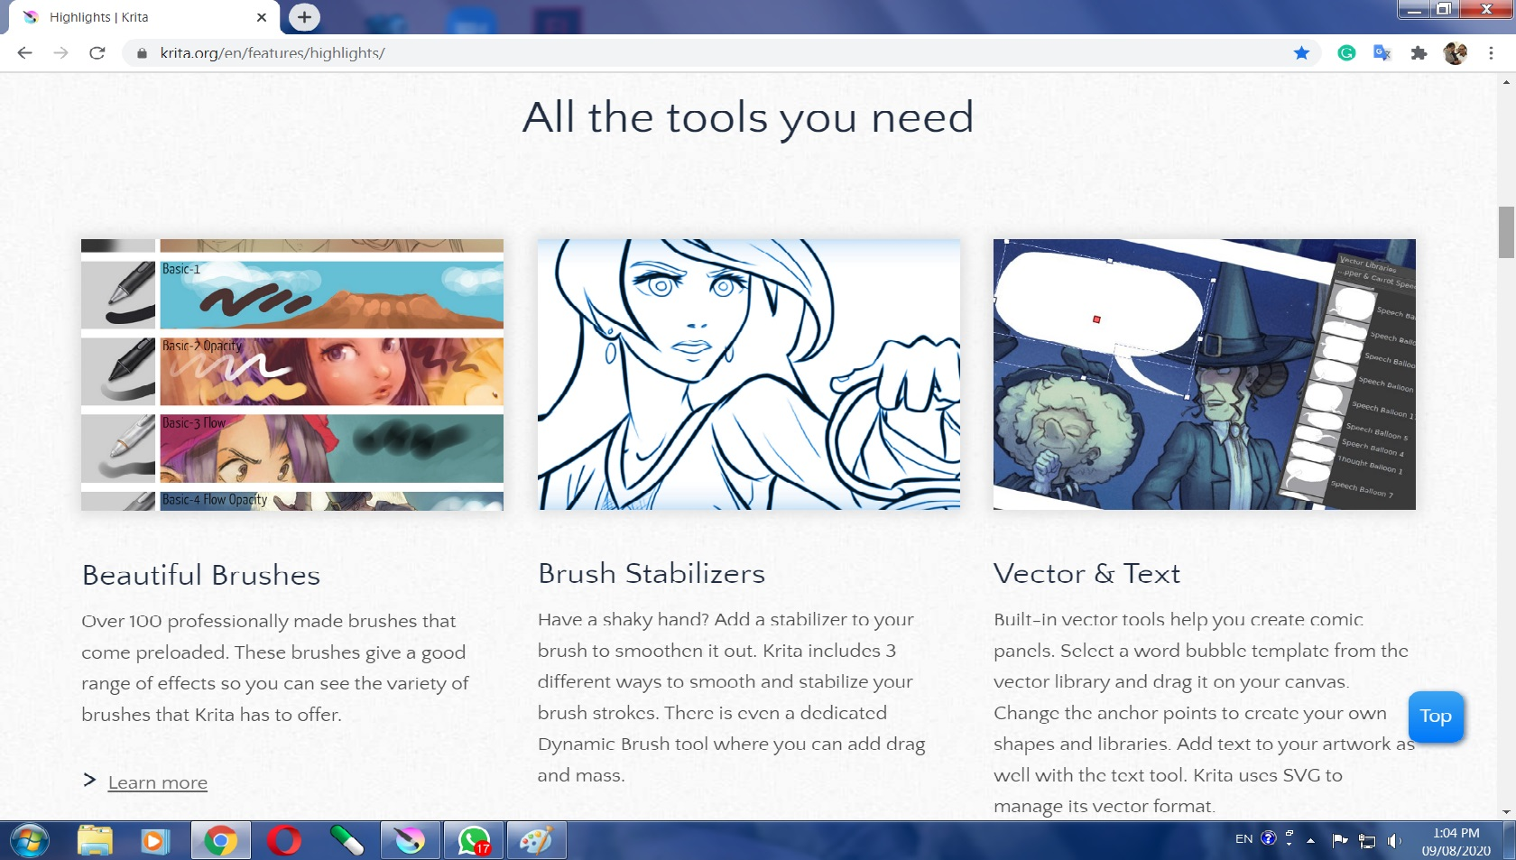
By- Santosh Kumar Bisen , Fulbright DAI Scholar- 9340089454

Slide 12
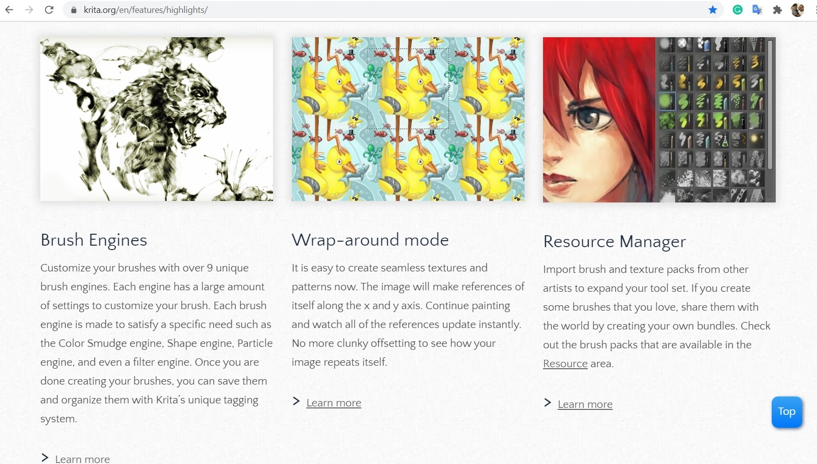
By- Santosh Kumar Bisen , Fulbright DAI Scholar- 9340089454

Slide 13
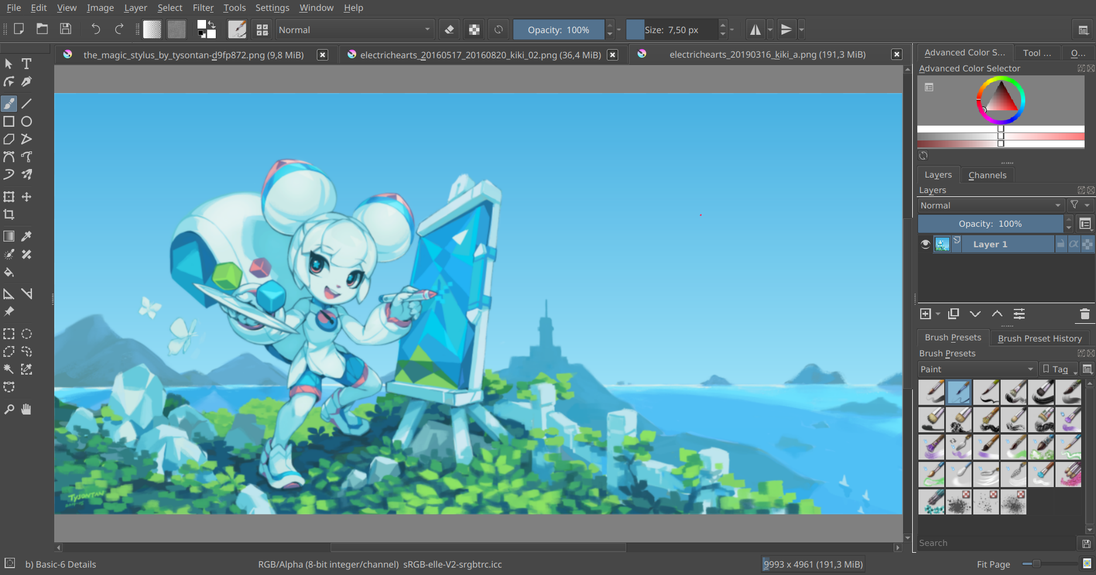
By- Santosh Kumar Bisen , Fulbright DAI Scholar- 9340089454

Slide 14
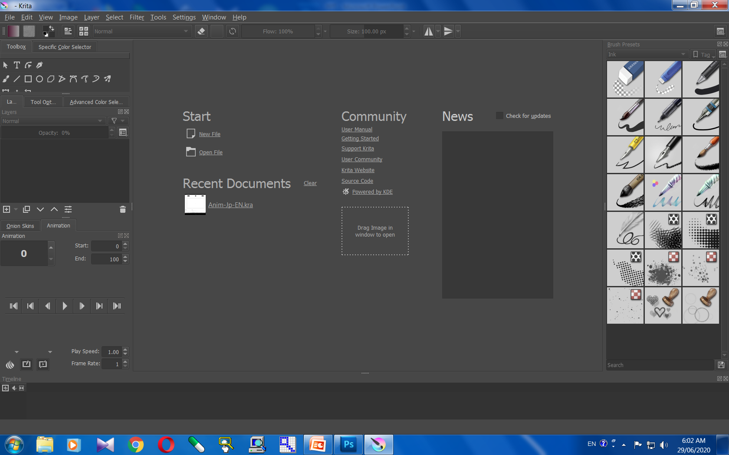
By- Santosh Kumar Bisen , Fulbright DAI Scholar- 9340089454

Slide 15
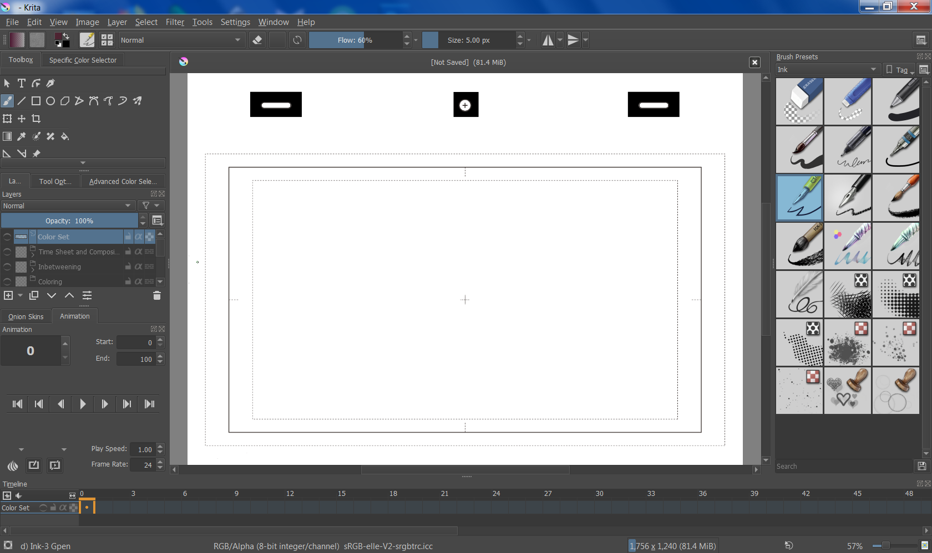
By- Santosh Kumar Bisen , Fulbright DAI Scholar- 9340089454

Slide 16
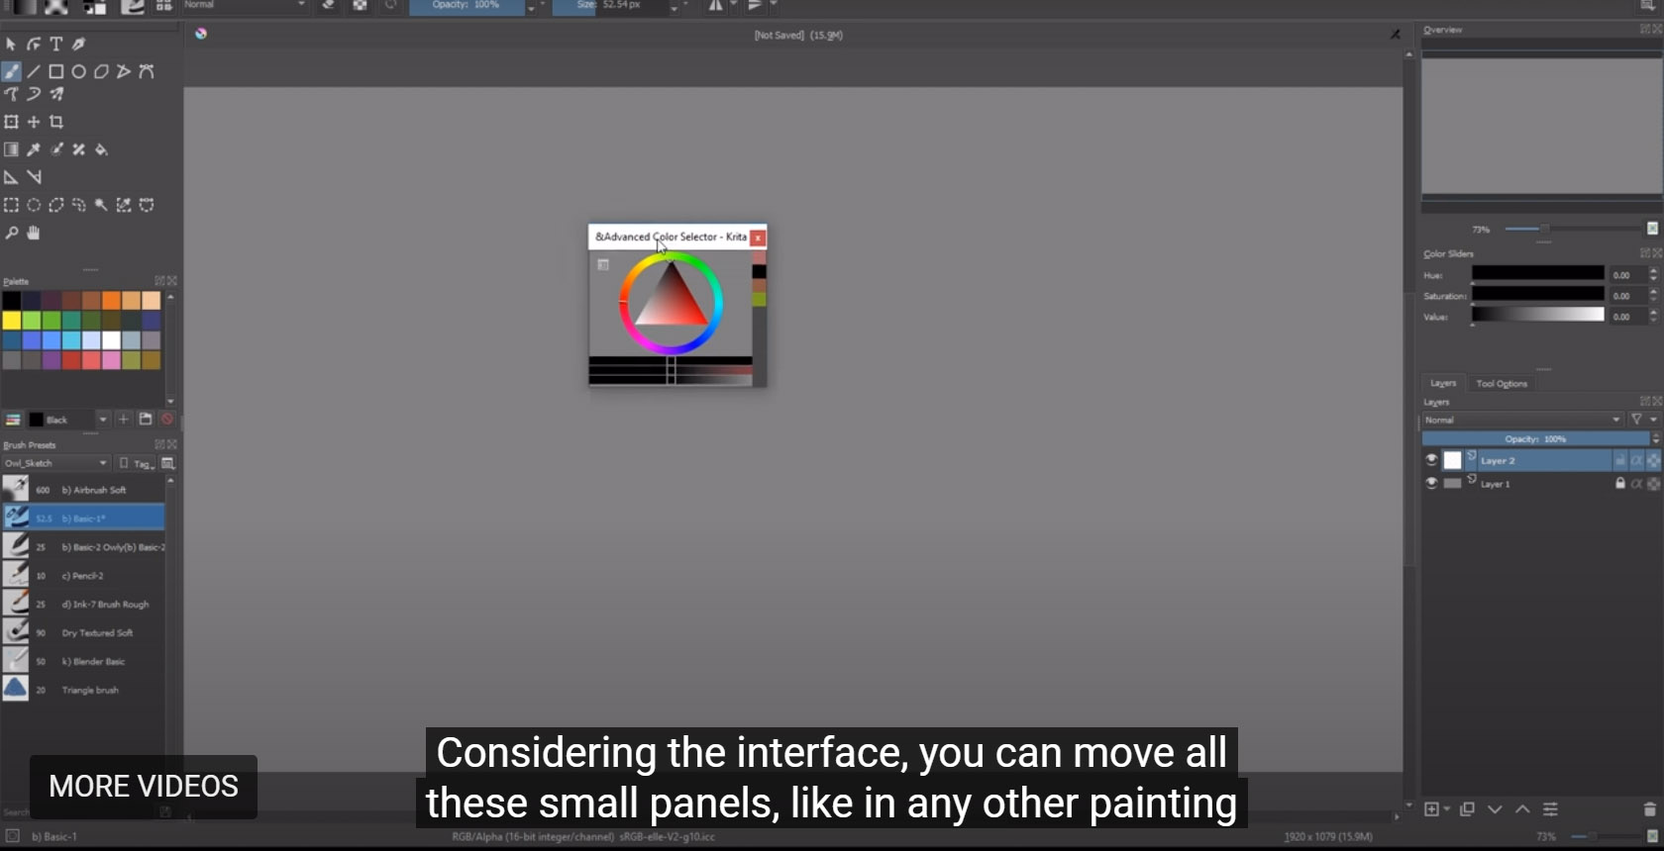
COLORS
By- Santosh Kumar Bisen , Fulbright DAI Scholar- 9340089454

Slide 17
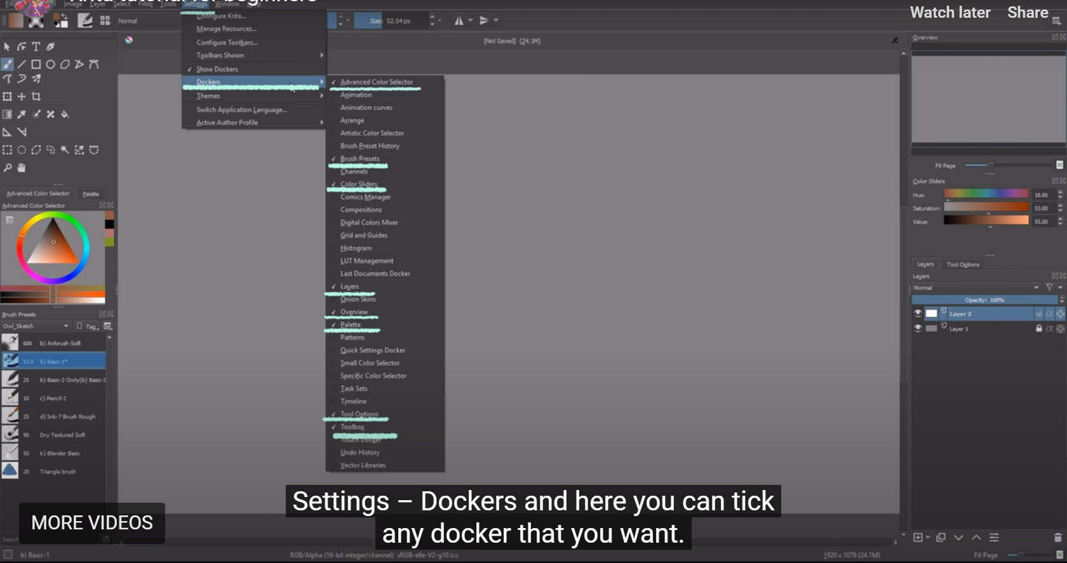
ALL THE TOOLS IN DOCKERS
By- Santosh Kumar Bisen , Fulbright DAI Scholar- 9340089454

Slide 18
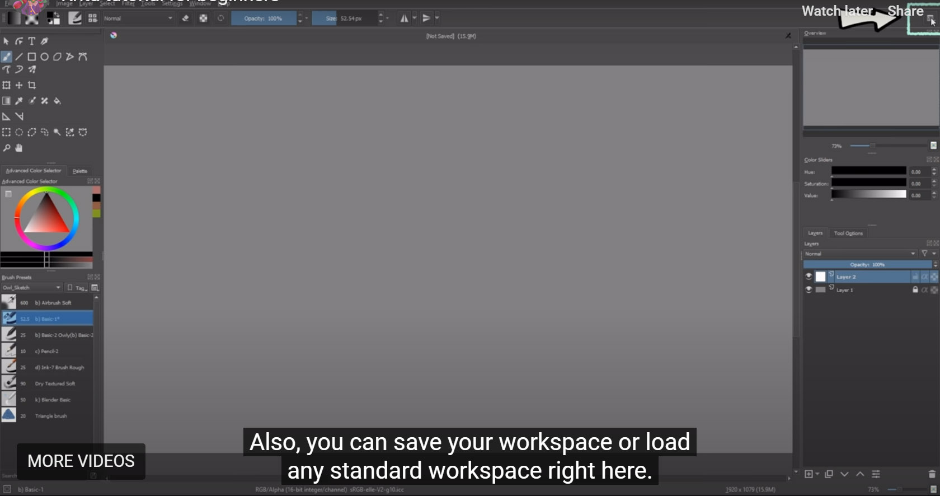
DOCKERS IN SHORT CUT
By- Santosh Kumar Bisen , Fulbright DAI Scholar- 9340089454

Slide 19
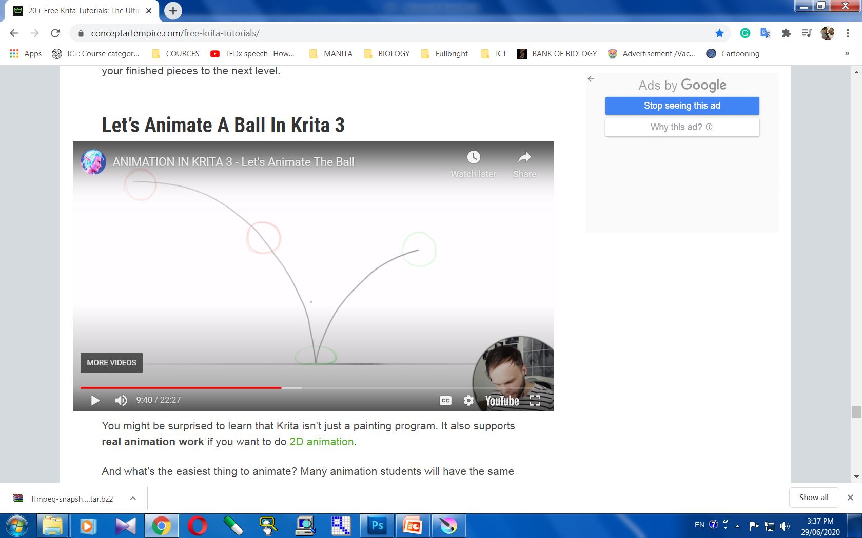
https://youtu.be/5mMQJVj0RYk
By- Santosh Kumar Bisen , Fulbright DAI Scholar- 9340089454

Slide 20
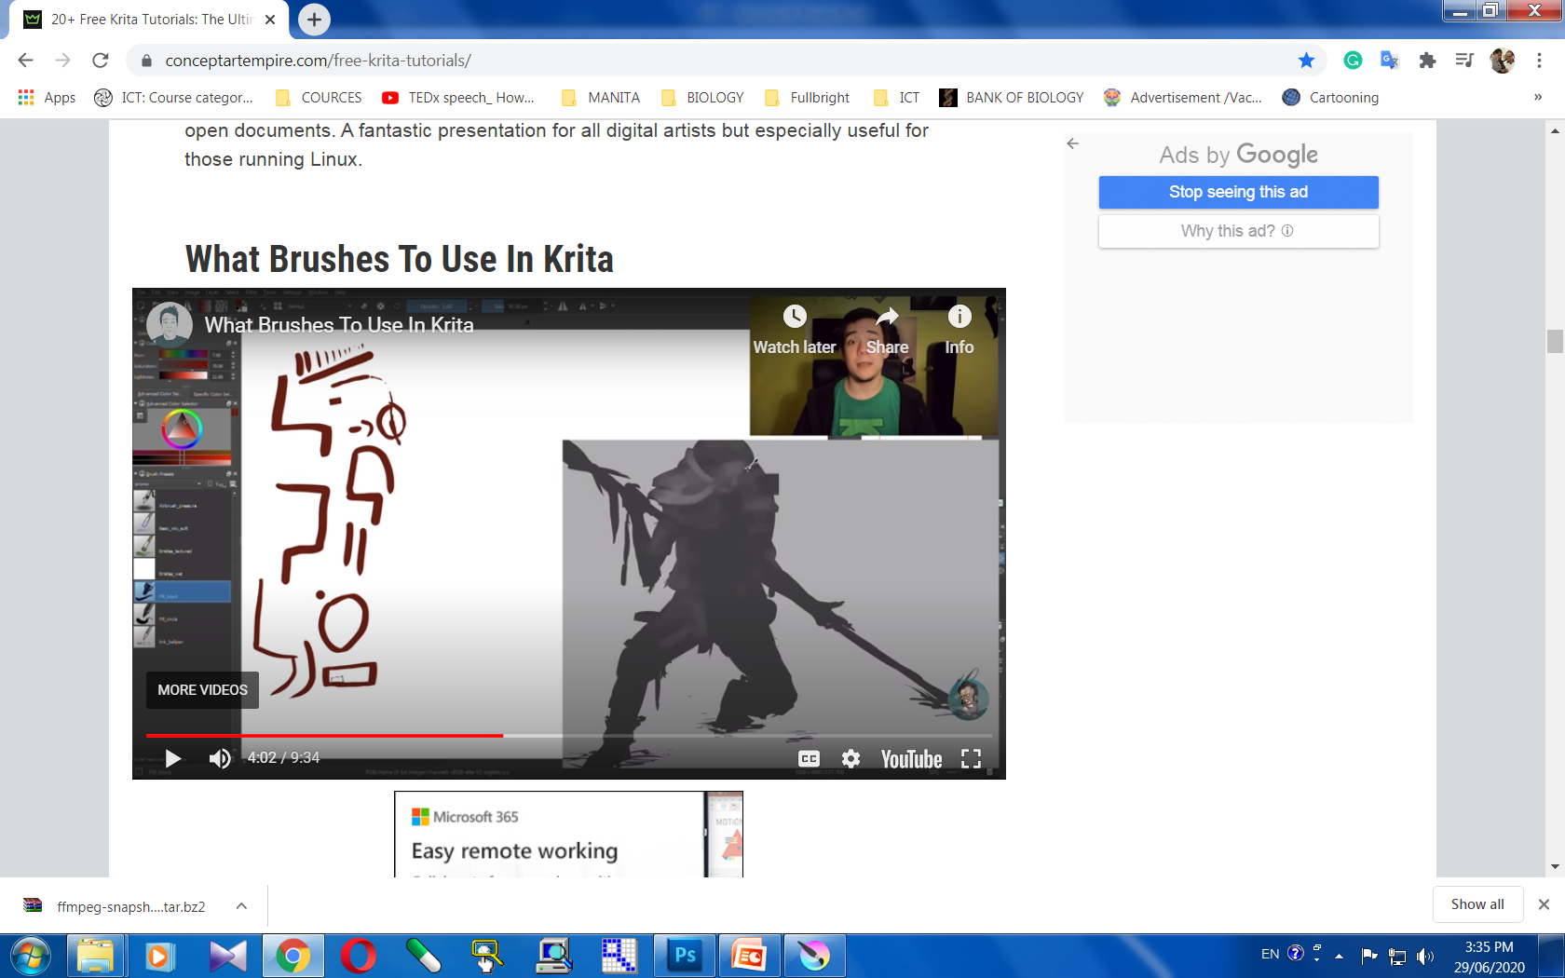
https://youtu.be/aS4Ng7SdIQM
By- Santosh Kumar Bisen , Fulbright DAI Scholar- 9340089454

Slide 21
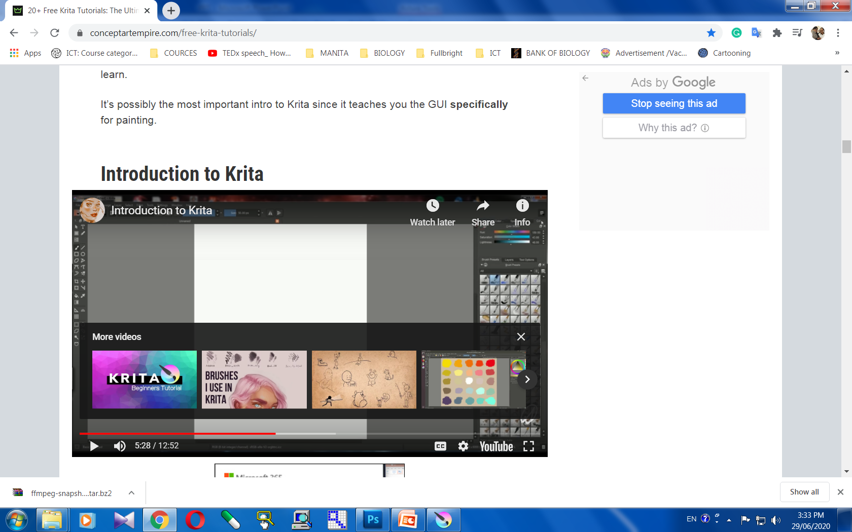
https://youtu.be/kUXNEK8awiY
By- Santosh Kumar Bisen , Fulbright DAI Scholar- 9340089454

Slide 22
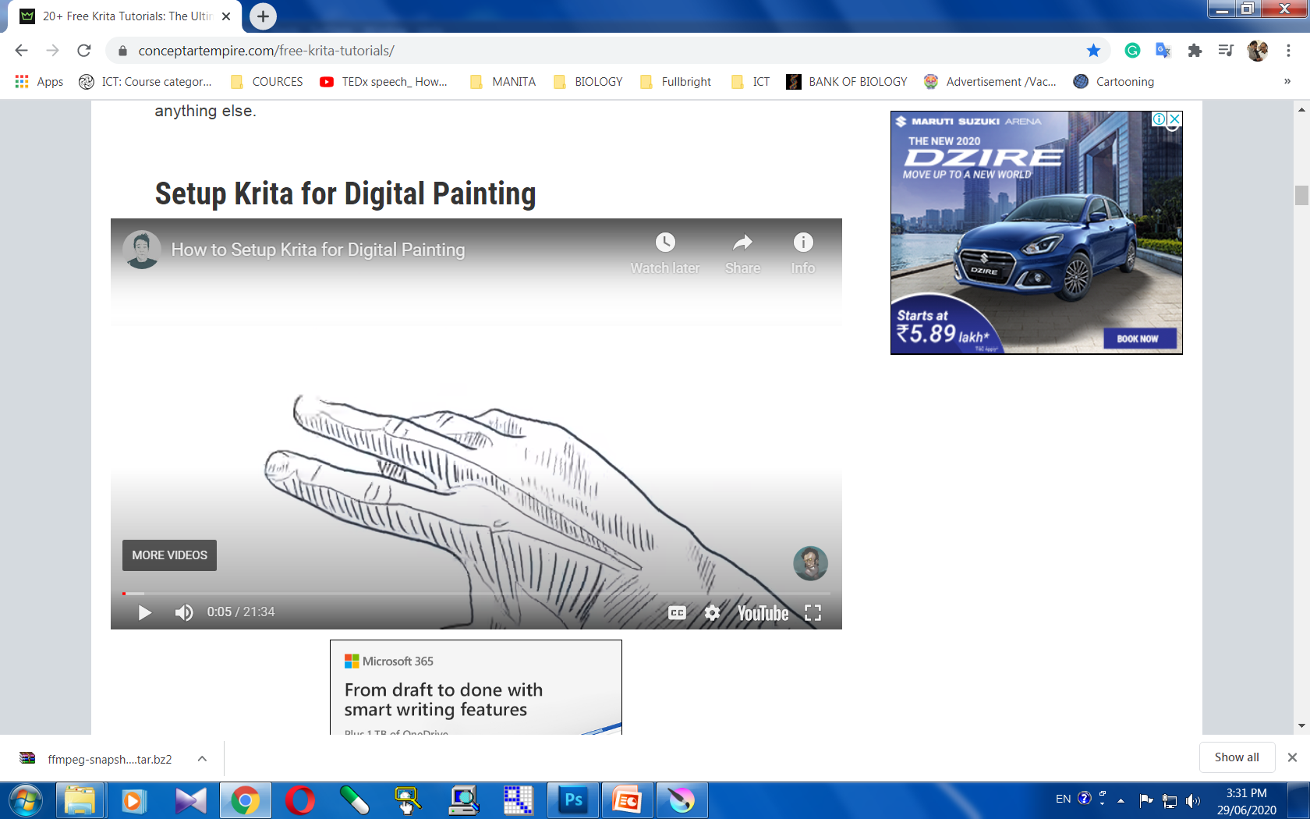
https://youtu.be/3dxRuXmRChs
By- Santosh Kumar Bisen , Fulbright DAI Scholar- 9340089454

